Slide 1
Object Oriented Programming (OOP)
Week – 09 and 10
Dated: 04/11/2024, 06/11/2024 and 11/11/2024, 13/11/2024
Instructor: AHMED AWAIS

Slide 2
Do you remember a take home question that I assigned you – Anyone please answer

Slide 3
1. Shape as a Concrete Class
If Shape is a concrete class (not declared with the abstract keyword), it can be instantiated directly. However, if it doesn't have any methods, it serves primarily as a base class for further specialization.
2. Inheritance
Inheritance allows you to create subclasses (like Rectangle and Circle) that can extend the functionality of the Shape class. Even if Shape does not have any methods or properties, it can still be a valid superclass.
3. Polymorphism
If Rectangle and Circle are both subclasses of Shape, you can reference them using a Shape type
Shape r1 = new Rectangle();
Shape c1 = new Circle();
This is an example of polymorphism, where a superclass reference (in this case, Shape) can point to subclass objects (Rectangle and Circle). This allows you to treat different shapes uniformly through their shared superclass reference.
4. No Abstract Methods Needed
You don't need to have abstract methods in a class for it to be useful in an inheritance hierarchy. The class can still provide a common interface for its subclasses.
Concrete methods can be added later to Shape, and if you do, all subclasses can inherit these methods.

Slide 4
Recap – Inheritance
Derived class inherits all the characteristics of the base class
Besides inherited characteristics, derived class may have its own unique characteristics
Major benefit of inheritance is reuse

Slide 5
Generalization and Specialization
In OO models, some classes may have common characteristics
We extract these features into a new class and inherit original classes from this new class
This concept is known as Generalization

Slide 6
Generalization and Specialization
Specialization is the process of creating subclasses from a general superclass to represent more specific entities. It involves refining the general class's attributes and behaviors to meet the needs of particular types.
This concept is known as Specialization
Like a method like bark() in Dog class
A bird can fly() is a special type of Animal class

Slide 7
Use of generalization
Used for three purposes:
Support of polymorphism:
You can call an operation at the superclass level, and the OO language compiler automatically resolves the call to the method that matches the calling object's class
polymorphism increases the flexibility of software
Adding a new subclass and automatically inheriting superclass behavior. Furthermore, the new subclass does not disrupt existing code..
Structuring the description of objects:
organizing objects on the basis of their similarities and differences(classification).
Enabling code reuse:
Reuse is more productive than repeatedly writing code from scratch.

Slide 8
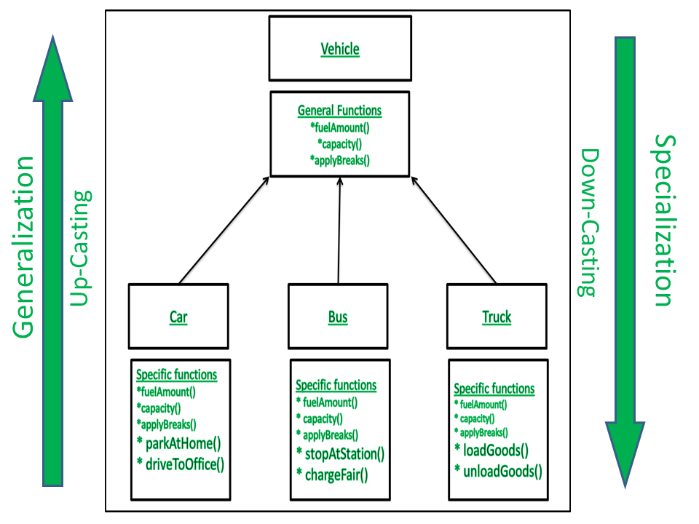

Slide 9
Example – Generalization
Line
Circle
Triangle
color
vertices
length
color
vertices
radius
color
vertices
angle
move
setColor
getLength
move
setColor
computeArea
move
setColor
computeArea

Slide 10
Shape
color
vertices
move
setColor
Triangle
Circle
radius
Line
angle
computeArea
length
computeArea
getLength

Slide 11
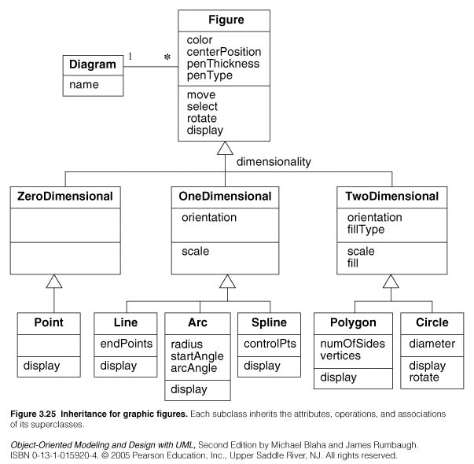

Slide 12
Polymorphism
The process of representing one Form in multiple forms is known as Polymorphism
Polymorphism is derived from 2 Greek words: poly and morphs. The word "poly" means many and morphs means forms. So polymorphism means many forms.

Slide 13
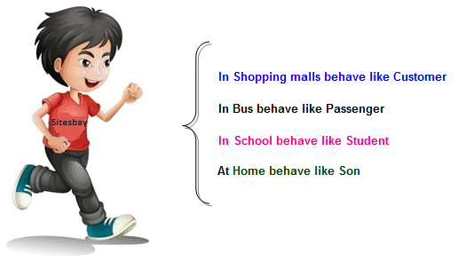
Real life example of Polymorphism
Suppose if you are in class room that time you behave like a student, when you are in market at that time you behave like a customer, when you at your home at that time you behave like a son or daughter, Here one person have different-different behaviors.

Slide 14
Type of Polymorphism
Static / Compile time polymorphism
Dynamic / Run time polymorphism

Slide 15
Static / Compile time polymorphism
It is also called Early Binding
It happens where more than one methods share the same name with different parameters or signature and different return type.
It is known as Early Binding because the compiler is aware of the functions with same name and also which overloaded function is to be called is known at compile time.

Slide 16
Function/Method Overloading
Whenever same method name is exiting multiple times in the same class with different number of parameter or different order of parameters or different types of parameters is known as method overloading

Slide 17
Valid Overloading Example
For add to be overloaded correctly, it would need to have different parameter types or a different number of parameters. Here’s how you could correctly overload add:
void add(int a, int b) { /* implementation */ }
void add(int a, int b, int c) { /* implementation */ } // Different number of parameters
void add(double a, double b) { /* implementation */ } // Different parameter types

Slide 18
Static / Compile time polymorphism
Overloading
Function Overloading (ALREADY DISCUSSED)
Constructor Overloading (ALREADY DISCUSSED)
Operator Overloading (NOT SUPPORTED IN JAVA)

Slide 19
Dynamic / Run time polymorphism
This refers to the entity which changes its form depending on circumstances at runtime. This concept can be adopted as analogous to a chameleon changing its color at the sight of an approaching object.
Method Overriding uses runtime Polymorphism.
It is also called Late Binding.

Slide 20
Dynamic / Run time polymorphism
Runtime Polymorphism is done using virtual and inheritance.
When overriding a method, the behavior of the method is changed for the derived class.

Slide 21
Overriding
A class may need to override the default behavior provided by its base class
Reasons for overriding
Provide behavior specific to a derived class
Extend the default behavior
Restrict the default behavior
Improve performance

Slide 22
Function/Method Overriding
Define any method in both base class and derived class with same name, same parameters or signature, this concept is known as method overriding

Slide 23
Example – Specific Behavior
color
vertices
draw
move
setColor
Triangle
Circle
radius
Line
angle
draw
computeArea
length
draw
computeArea
draw

Slide 24
Example – Improve Performance
Shape
color
coord
Class Circle overrides rotate operation of class Shape with a Null operation.
draw
rotate
setColor
Circle
radius
draw
rotate

Slide 25
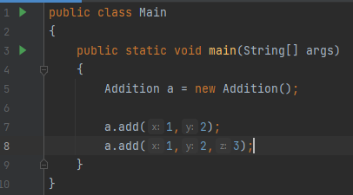
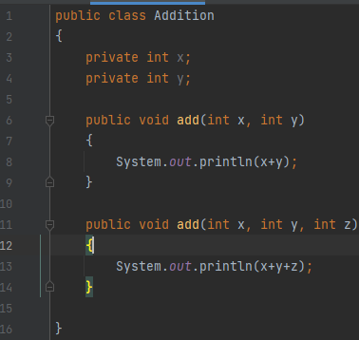
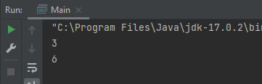
Example (Overloading)

Slide 26
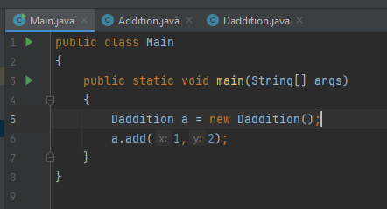
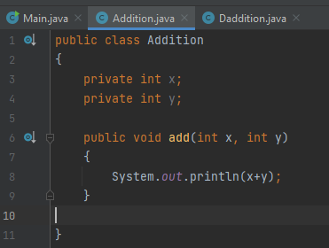
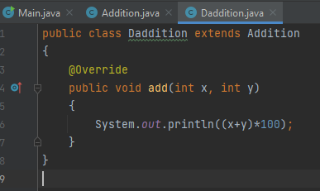
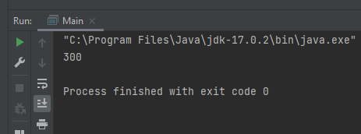
Example (Overriding)

Slide 27
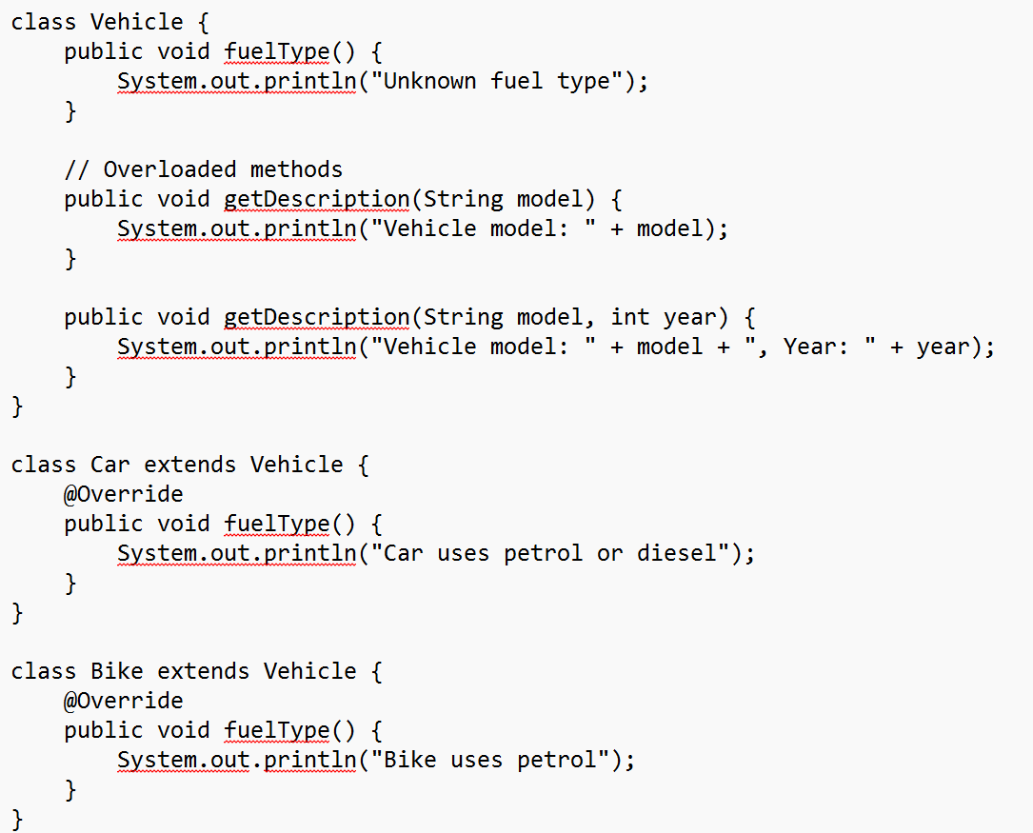
The example implementation is incomplete, you should create main() to create objects and call method and see how they are working differently.

Slide 28
E-Commerce Scenario (Abstract Classes, Polymorphism, final methods)
Problem: Design an abstract class Product that has subclasses Electronics and Clothing. Implement a calculateDiscount method that provides a different discount calculation for each type of product.
Requirements:
Product should have an abstract calculateDiscount method.
Use a final method to display the product's base price.
Override calculateDiscount in subclasses to calculate discounts.

Slide 29
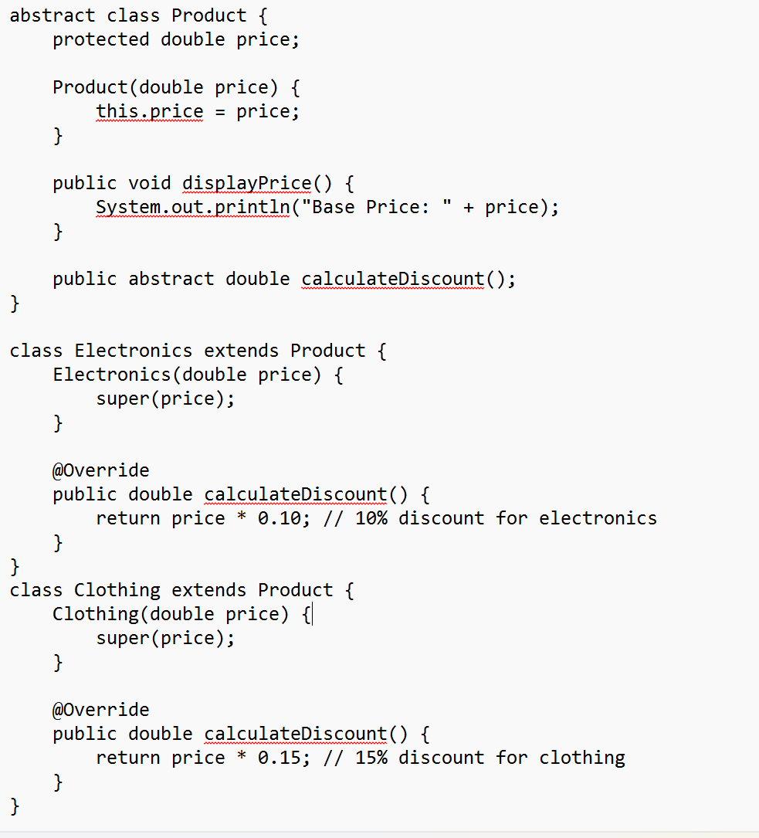
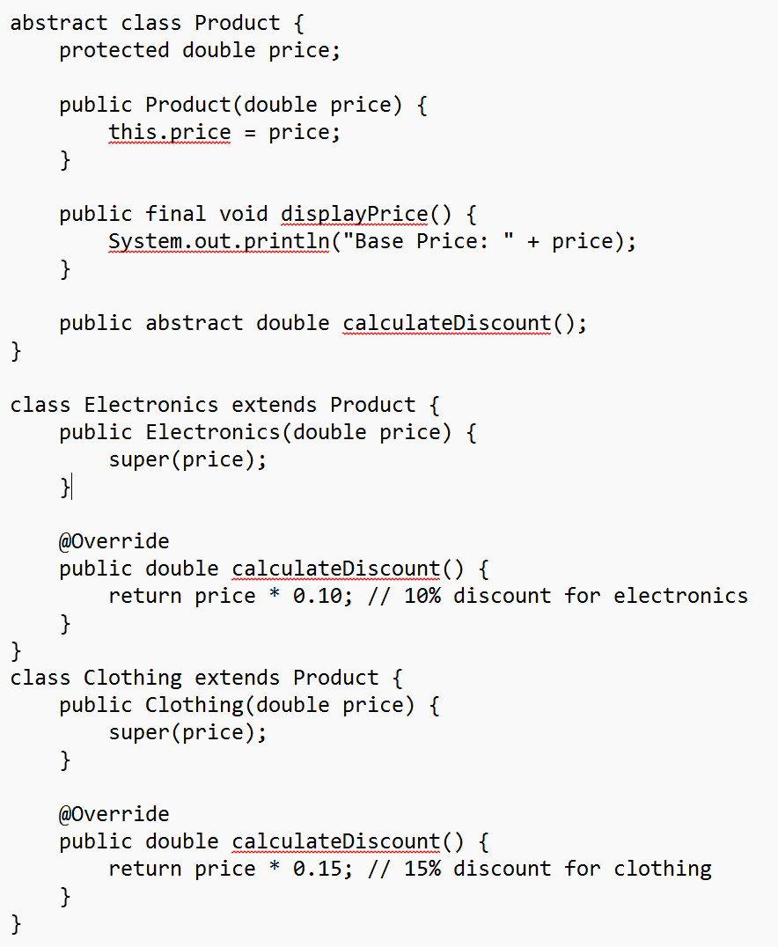
Problem: Design an abstract class Product that has subclasses Electronics and Clothing. Implement a calculateDiscount method that provides a different discount calculation for each type of product.
The example implementation is incomplete, you should create main() to create objects and call calculateDiscount() and see how it working differently.

Slide 30
Static and FINAL Keywords
The two really aren't similar (as of concepts) but for better understanding I am delivering lecture on both keywords together

Slide 31
Static Members of a Class
We can define class members static using static keyword.
When we declare a member of a class as static it means no matter how many objects of the class are created, there is only one copy of the static member.
A static member is shared by all objects of the class.
All static data is initialized to zero when the first object is created, if no other initialization is present.

Slide 32
The static keyword can be used in 4 scenarios
static variables
static methods
static blocks of code
static nested class – Not covered yet
Let's look at static variables and static methods first.
Static variable
It is a variable which belongs to the class and not to object (instance).
Static variables are initialized only once, at the start of the execution. These variables will be initialized first, before the initialization of any instance variables.
A single copy to be shared by all instances of the class.
A static variable can be accessed directly by the class name and doesn’t need any object.
Syntax: Class.variable

Slide 33
Static method
It is a method which belongs to the class and not to the object (instance).
A static method can access only static data. It can not access non-static data (instance variables) unless it has/creates an instance of the class.
A static method can call only other static methods and can not call a non-static method from it unless it has/creates an instance of the class.
A static method can be accessed directly by the class name and doesn’t need any object.
Syntax: Class.methodName()
A static method cannot refer to this or super keywords in anyway.

Slide 34
Static class
Java also has "static nested classes” (for now out of coverage). A static nested class is just one which doesn't implicitly have a reference to an instance of the outer class.
Static nested classes can have instance methods and static methods.
There's no such thing as a top-level static class in Java.
Side note:
main method is static since it must be be accessible for an application to run before any instantiation takes place.

Slide 35
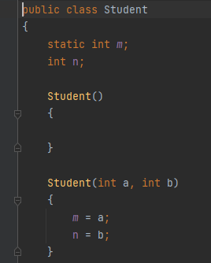
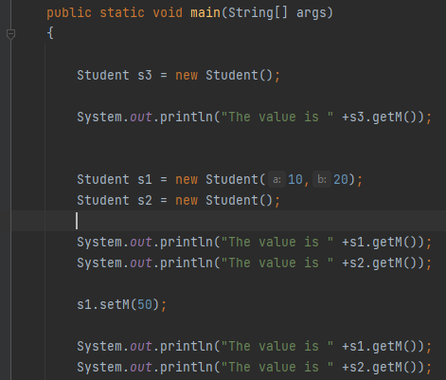
Example

Slide 36
Static Member Functions of a Class
By declaring a function member as static, you make it independent of any particular object of the class
It can be called without an instance.
A static member function can be called even if no objects of the class exist and the static functions are accessed using only the class name and the scope resolution operator ::
A static member function can only access static data member, other static member functions and any other functions from outside the class.

Slide 37
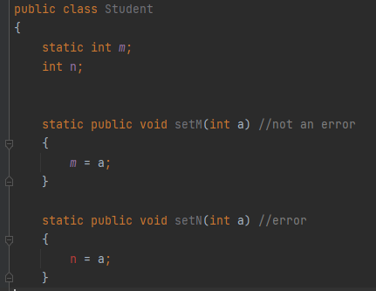
Concept: A static member function can only access static data member

Slide 38
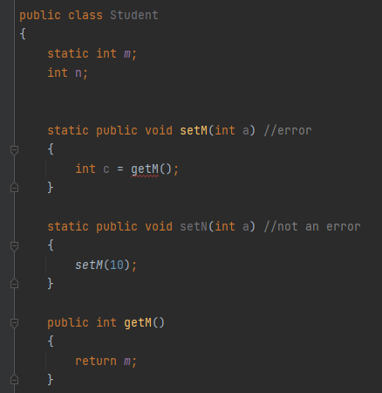
Concept: A static member function can only access other static member functions

Slide 39
Concept: A static member function can be called even if no objects of the class exist
[class name].[method name]
Student.SetM(10);

Slide 40
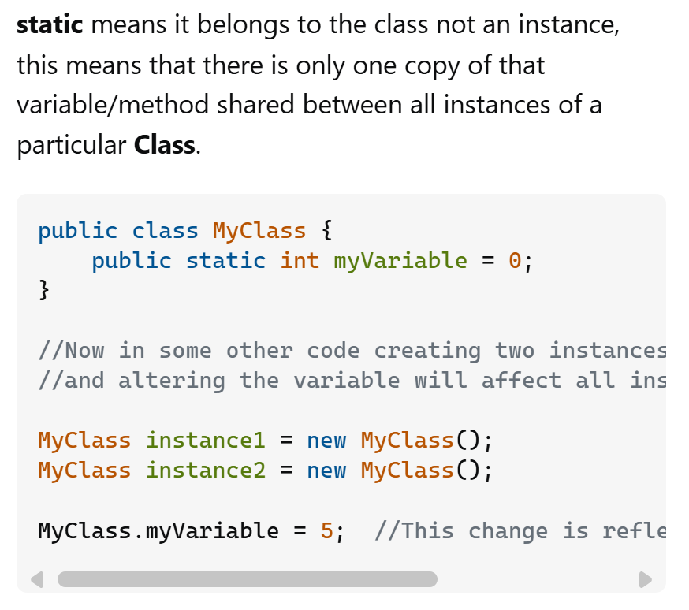

Slide 41
final KEYWORD
Final(constant) is something that doesn't change.
In JAVA, we use the keyword final to make program elements constant.
If you make any variable as final, you cannot change the value of final variable(It will be constant)

Slide 42
final KEYWORD
final keyword is used in several different contexts to define an entity which cannot later be changed.
A final class cannot be subclassed. This is done for reasons of security and efficiency. Accordingly, many of the Java standard library classes are final, for example java.lang.System and java.lang.String. All methods in a final class are implicitly final.

Slide 43
final KEYWORD
A final method can't be overridden by subclasses. This is used to prevent unexpected behavior from a subclass altering a method that may be crucial to the function or consistency of the class.
A final variable can only be initialized once, either via an initializer or an assignment statement.
It does not need to be initialized at the point of declaration, this is called a blank final variable, but in this case:

Slide 44
Create a Vehicle Class and perform Specialization for upto three classes. Use speedlimit as FINAL keyword and try to edit/update from main, you should get error.

Slide 45
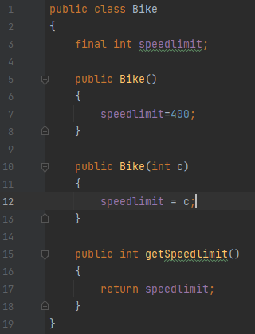
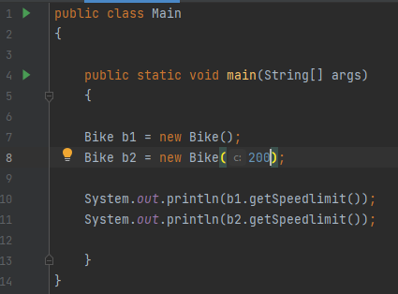
Example

Slide 46
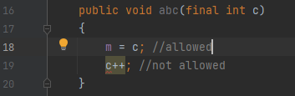
Function with final Arguments
We can make the arguments of a function as const. Then we cannot change any of them.

Slide 47
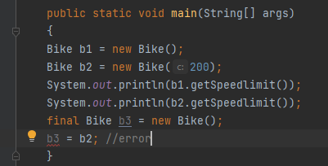
Defining Class Object as final

Slide 48
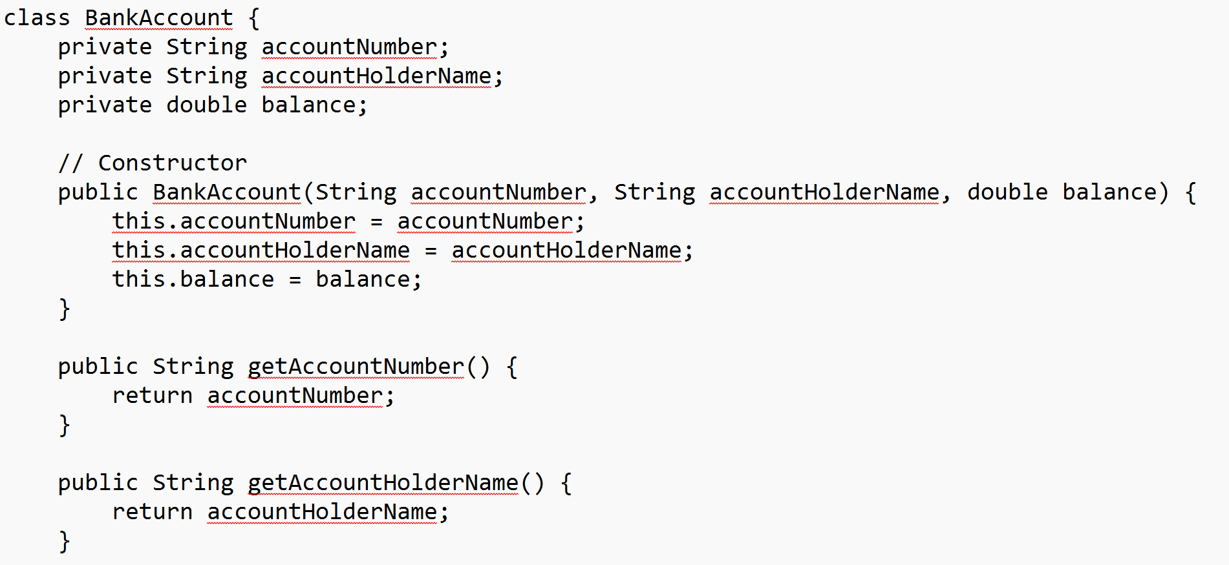

Slide 49
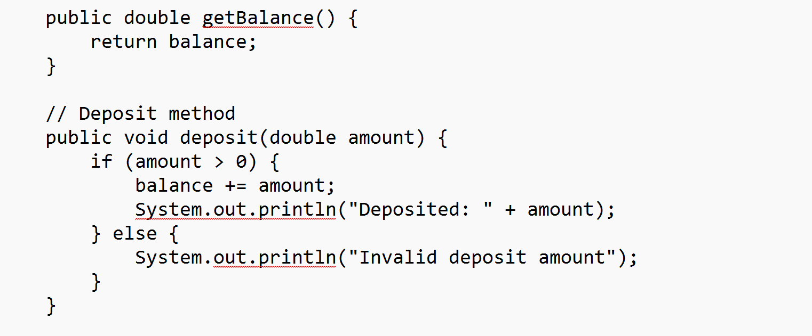

Slide 50
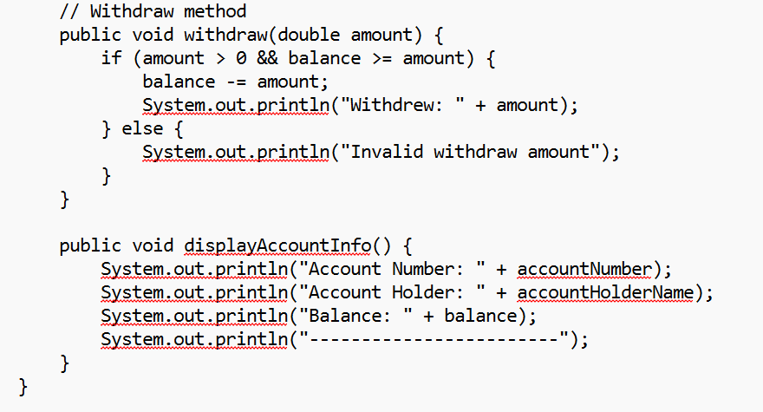

Slide 51
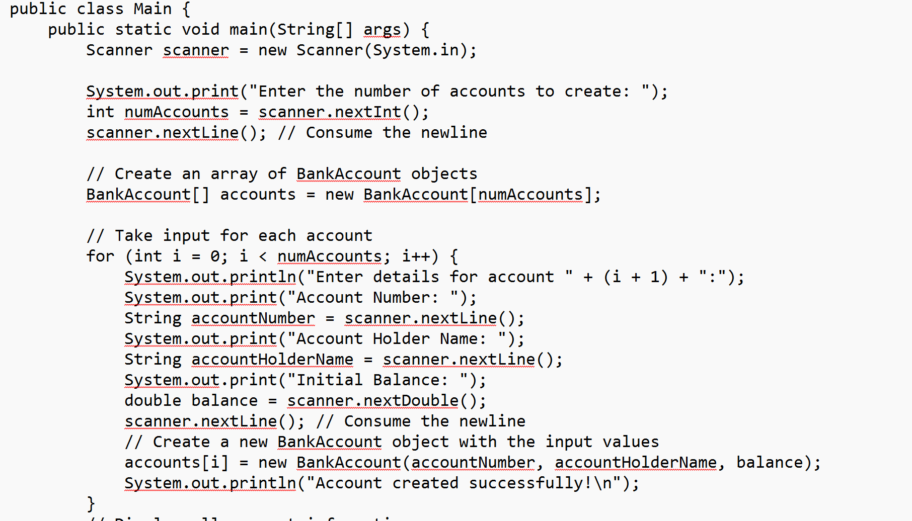

Slide 52
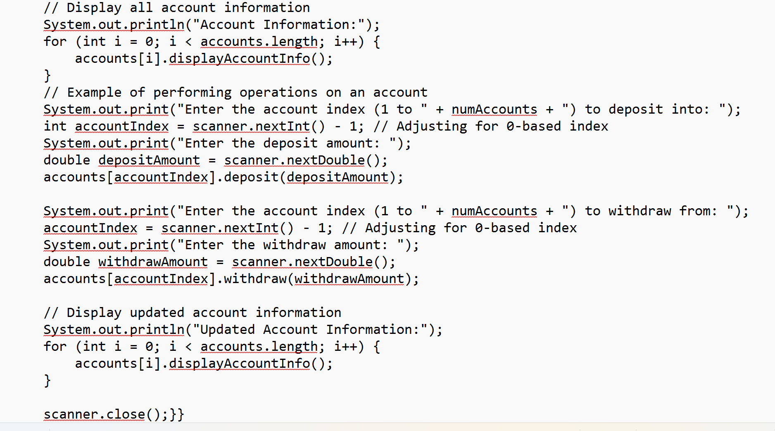

Slide 53
Homework: Let’s further extend BankAccount
BankAccount (Base Class): The base class for all types of accounts. It will demonstrate Encapsulation by keeping the account details private and providing public methods to access them. This class will also have a final account number that cannot be changed.
SavingsAccount, CheckingAccount, LoanAccount (Derived Classes): Each subclass will inherit from BankAccount and represent specific types of accounts, demonstrating Inheritance and Polymorphism. Each account type can have its unique interest rate and fees.
Bank Utility (Static Class): This class will provide static methods for overall bank operations, such as tracking the number of accounts created, showing bank information, etc. A static variable will keep track of the total number of accounts.
Main (Driver Class): The Main class will tie everything together by handling user input and account operations, demonstrating the functionality and use of OOP pillars.

Slide 54
Reading Assignment!
Dietel, 7th Edition
Classes: A Deeper Look, Part 2
10.2 const (Constant) Objects and const Member Functions
10.6 static Class Members

Slide 55
Try static in C++ (optional not in coverage)

Slide 56
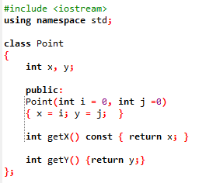
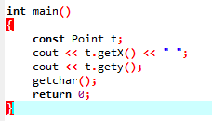
Exercise!

Slide 57
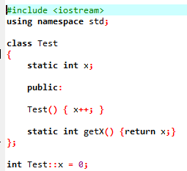
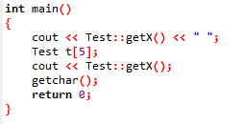
Exercise!

Slide 58
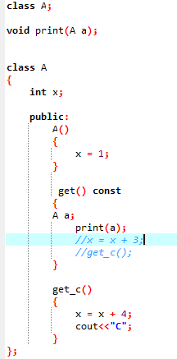
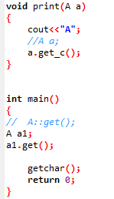
Exercise!

Slide 59
Saving Account Class
Create a SavingsAccount class. Use a static data member annualInterestRate to store the annual interest rate for each of the savers. Each member of the class contains a private data member savingsBalance indicating the amount the saver currently has on deposit. Provide member function calculateMonthlyInterest that calculates the monthly interest by multiplying the balance by annualInterestRate divided by 12; this interest should be added to savingsBalance. Provide a static member function modifyInterestRate that sets the static annualInterestRate to a new value. Write a driver program to test class SavingsAccount. Instantiate two different objects of class SavingsAccount, saver1 and saver2, with balances of $2000.00 and $3000.00, respectively. Set the annualInterestRate to 3 percent. Then calculate the monthly interest and print the new balances for each of the savers. Then set the annualInterestRate to 4 percent, calculate the next month’s interest and print the new balances for each of the savers.

Slide 60
Recap from 61 to 72 slides

Slide 61
Abstraction (Recap)
Abstraction is a process of hiding the implementation details and showing only functionality to the user.
Abstraction lets you focus on what the object does instead of how it does it.

Slide 62
Ways to achieve Abstraction
There are two ways to achieve abstraction in java
Abstract class (0 to 100%)
Interface (100%)

Slide 63
The degree of abstraction (%)
The percentages here (0 to 100% for an abstract class and 100% for an interface) represent the degree of abstraction provided by each construct:
Abstract Class (0 to 100%):
An abstract class can have a mix of abstract methods (which have no implementation and must be overridden by subclasses) and concrete (non-abstract) methods (which have an implementation). This means an abstract class can provide partial abstraction, anywhere from 0% to 100%.
0% abstraction: An abstract class could technically have all concrete methods, though it would usually still be abstract to enforce inheritance rules.
100% abstraction: If all methods in an abstract class are abstract, then the class is fully abstract, similar to an interface in its function (but it still cannot be instantiated directly).

Slide 64
The degree of abstraction (%)
Interface (100%):
An interface represents 100% abstraction because, traditionally in Java (before Java 8), interfaces could only declare abstract methods, and any class implementing an interface had to provide the implementation for all its methods.
In modern Java, interfaces can include default methods with implementations, which slightly blurs this line, but the purpose remains to define a contract for subclasses.

Slide 65
Abstract Class
A class which is declared as abstract is known as an abstract class. It can have abstract and non-abstract methods. It needs to be extended and its method implemented. It cannot be instantiated.

Slide 66
Points to Remember
An abstract class must be declared with an abstract keyword.
It can have abstract and non-abstract methods.
It cannot be instantiated.
It can have constructors and static methods also.
It can have final methods which will force the subclass not to change the body of the method.

Slide 67
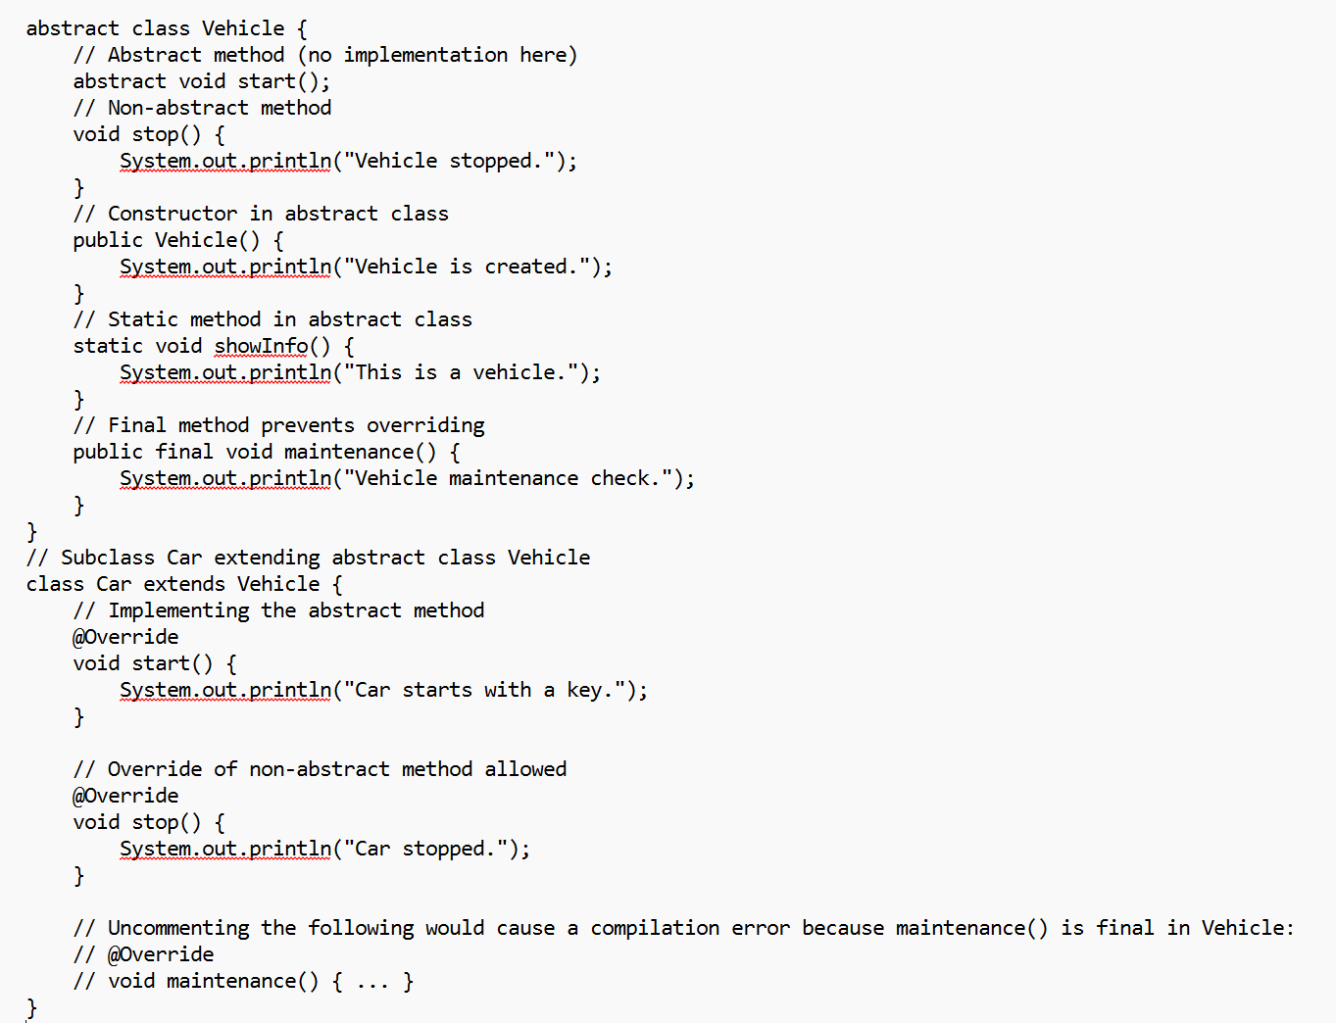

Slide 68
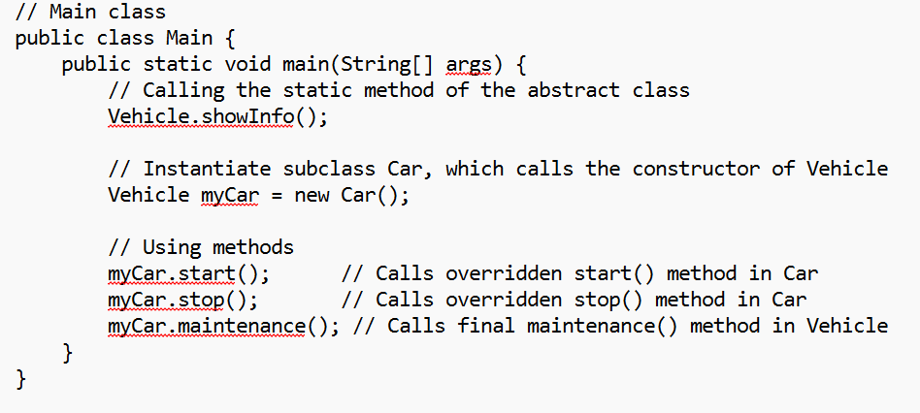
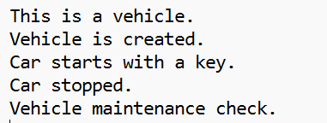

Slide 69
Feature | Abstract Class | Concrete Class
Definition | A class that cannot be instantiated directly and may contain abstract methods (methods without a body). | A class that can be instantiated directly and has complete method implementations.
Instantiation | Cannot be instantiated. | Can be instantiated.
Abstract Methods | Can have abstract methods that must be implemented by subclasses. | Cannot have abstract methods; all methods must be implemented.
Concrete Methods | Can contain concrete (non-abstract) methods with implementations. | Contains all concrete methods with implementations.
Constructors | Can have constructors, but they cannot be used to create instances directly. | Can have constructors and are used to create instances of the class.
Inheritance | Can be subclassed; subclasses must implement abstract methods. | Can be subclassed but does not require subclasses to implement methods.
Purpose | Used to provide a base for subclasses with shared behavior while allowing customization. | Used to create objects that have specific behaviors and states.
Polymorphism | Supports polymorphism through abstract methods. Subclasses can override and provide specific implementations. | Supports polymorphism, but does not require method overriding.
Accessibility | Can have various access modifiers for its members (protected, public, private). | Can also have various access modifiers for its members.
Use Cases | Commonly used in situations where a common base with some shared functionality is needed, while leaving certain behaviors to be defined by subclasses. | Used when a complete implementation is needed, and objects can be created from the class.

Slide 70
Example
abstract class Bike { abstract void run(); } class Honda4 extends Bike { void run() { System.out.println("running safely"); } } | public static void main(String args[]) { Bike obj = new Honda4(); obj.run(); }

Slide 71
Abstract class having constructor, data member and methods
abstract class Bike{ Bike(){System.out.println("bike is created");} abstract void run(); void changeGear(){System.out.println("gear changed");} } class Honda extends Bike{ void run(){System.out.println("running safely..");} } | //Creating a Test class which calls abstract and non-abstract methods class TestAbstraction2{ public static void main(String args[]){ Bike obj = new Honda(); obj.run(); obj.changeGear(); } }

Slide 72
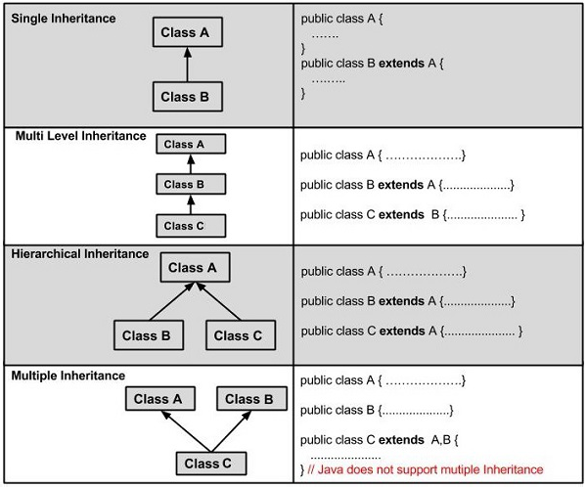

Slide 73
Interface in Java

Slide 74
Interfaces in Java
An Interface in Java programming language is defined as an abstract type used to specify the behavior of a class. An interface in Java is a blueprint of a class. A Java interface contains static constants and abstract methods.
The interface in Java is a mechanism to achieve abstraction.
All the methods in an interface are declared with an empty body and are public and all fields are public, static, and final by default.

Slide 75
Abstract Vs Interface
Interfaces are used to implement abstraction. So the question arises why use interfaces when we have abstract classes?
The reason is, abstract classes may contain non-final variables, whereas variables in the interface are final, public and static.

Slide 76
interface
// A simple interface
interface Player
{
final int id = 10;
int move();
}

Slide 77
Real-World Example
Let’s consider the example of vehicles like bicycle, car, bike………, they have common functionalities. So we make an interface and put all these common functionalities. And lets Bicycle, Bike, Car ….etc. implement all these functionalities in their own class in their own way.

Slide 78
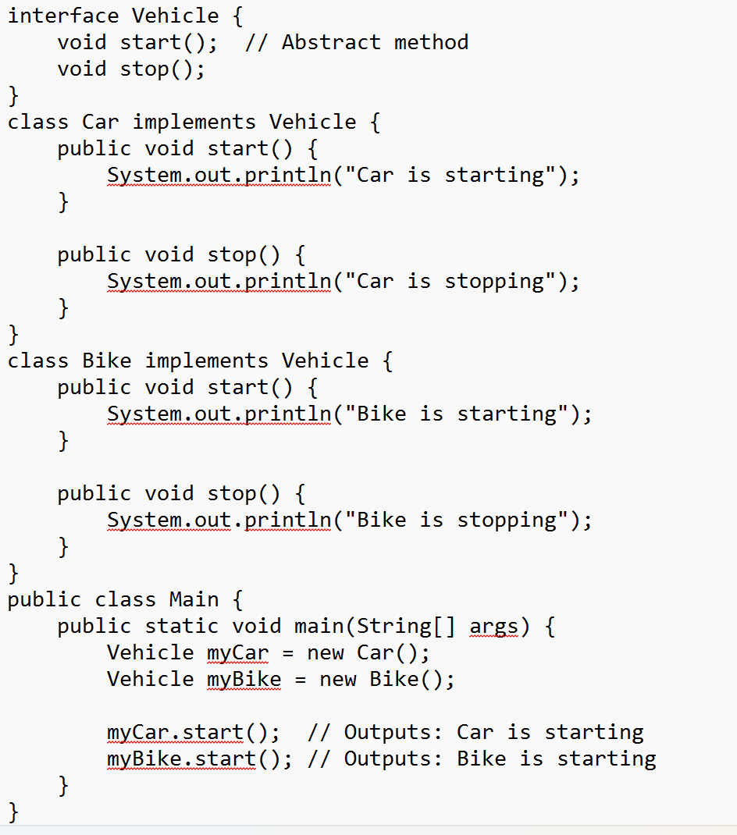
Implementing an Interface
A class implements an interface using the implements keyword.
The class must provide implementations for all abstract methods declared in the interface.

Slide 79
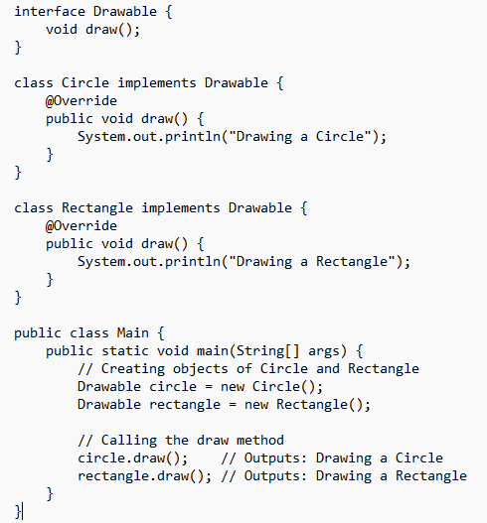
The class must provide implementations for all abstract methods declared in the interface.
Interface (Drawable): Contains an abstract method draw().
Implementing Classes (Circle and Rectangle): Implement the Drawable interface and provide implementations for the draw() method.
Using the Interface: Objects of Circle and Rectangle are created, and the draw() method is called.

Slide 80
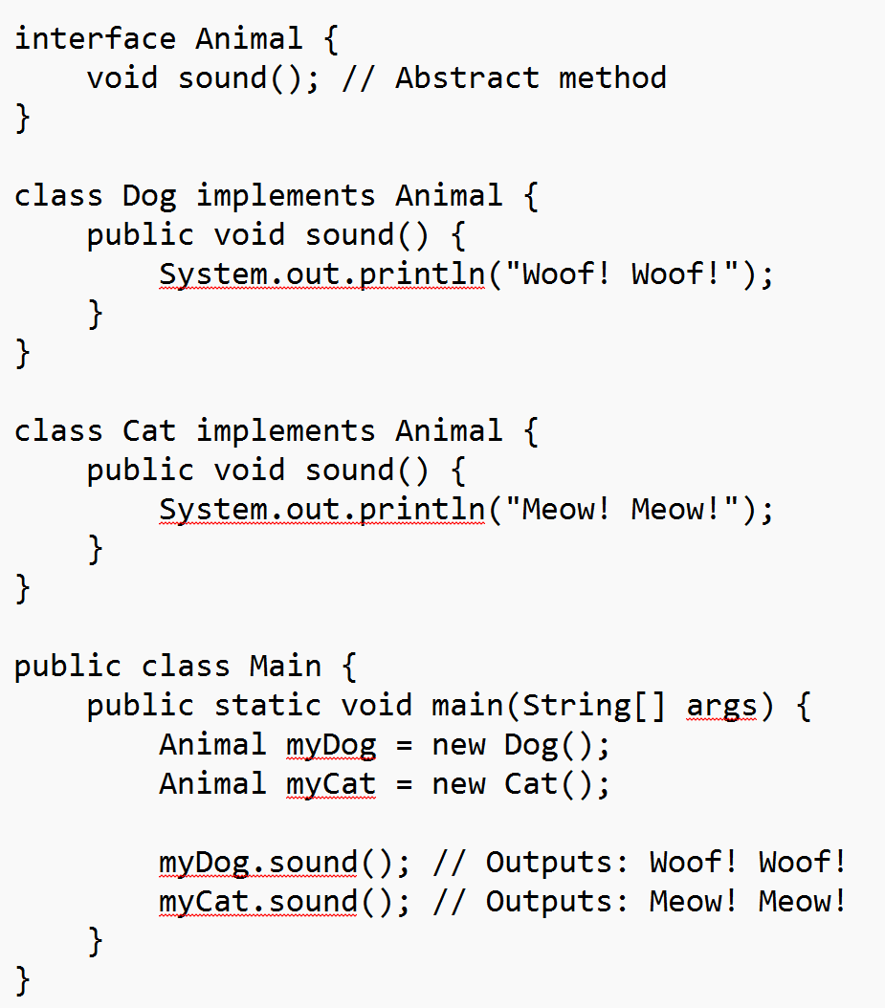
An Interface in Java is a blueprint for a class. It defines a set of abstract methods (methods without a body) that any class implementing the interface must provide. Interfaces are often used to achieve polymorphism, allowing a class to adhere to multiple behaviors without inheritance.

Slide 81
How Abstraction Works Here
The Interface (Animal):
The Animal interface declares the method sound() but doesn’t implement it. This means the Animal interface represents a generic concept or "blueprint" of what an animal is expected to do.
This abstract method sound() is a placeholder for a behavior that all animals (in this context) should have, but the details are left undefined.
Concrete Classes (Dog and Cat):
Dog and Cat are concrete classes that implement the Animal interface.
Each class provides its own specific implementation of the sound() method, showing how each type of animal sounds differently.
Achieving Abstraction:
By using the Animal interface, we are abstracting the idea of an "animal" with a "sound" without needing to know the exact details of each type of animal's sound.
The main program can refer to myDog and myCat as Animal types, only knowing that they have a sound() behavior, without needing to know how the sound() is implemented for each animal.

Slide 82
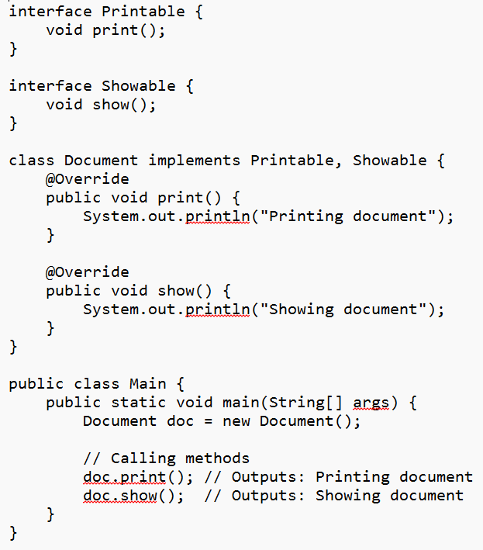
Example of Multiple Inheritance
Multiple Inheritance with Interfaces
A class can implement multiple interfaces, allowing it to inherit behavior from multiple sources.
Interfaces (Printable and Showable): Contain abstract methods print() and show().
Implementing Class (Document): Implements both Printable and Showable interfaces and provides implementations for the print() and show() methods.
Using the Class: An object of Document is created, and the methods are called.

Slide 83
Advantages of Interfaces
Multiple Inheritance: Allows a class to inherit behavior from multiple interfaces.
Decoupling: Reduces the dependency between classes, making the code more modular.
Flexibility: Provides a way to define methods that must be implemented by multiple classes, ensuring consistency.

Slide 84
Summary
Interface: A reference type in Java that can contain only constants, method signatures, default methods, static methods, and nested types.
Abstract Methods: Methods without implementation that must be implemented by classes that implement the interface.
Default Methods: Methods with implementation introduced in Java 8, allowing interfaces to have methods with a default implementation.
Static Methods: Methods with implementation that belong to the interface rather than any instance of the class.
Multiple Inheritance: A class can implement multiple interfaces, inheriting behavior from multiple sources.
Benefits: Interfaces provide abstraction, multiple inheritance, decoupling, and flexibility, making the code more modular and easier to maintain.
Understanding interfaces is crucial for designing robust and maintainable object-oriented code in Java.

Slide 85
Inner Class
In Java, inner class refers to the class that is declared inside class.
There are certain advantages associated with inner classes are as follows:
Making code clean and readable.
Private methods of the outer class can be accessed, so bringing a new dimension and making it closer to the real world.

Slide 86
Types of Inner Classes
There are basically four types of inner classes in java.
Nested Inner Class
Method Local Inner Classes
Static Nested Classes
Anonymous Inner Classes

Slide 87
Nested Inner Class
It can access any private instance variable of the outer class.
class Outer_Demo {
private int num = 175;
public class Inner_Demo {
public int getNum() {
System.out.println("This is the getnum method of the inner class");
return num; } } }}

Slide 88
Nested Inner Class
It can access any private instance variable of the outer class.
public class Main{
public static void main(String args[]) {
// Instantiating the outer class
Outer_Demo outer = new Outer_Demo();
// Instantiating the inner class
Outer_Demo.Inner_Demo inner = outer.new Inner_Demo();
System.out.println(inner.getNum()); } }
Outer.Inner in = new Outer().new Inner();

Slide 89
Method-local Inner Class
In Java, we can write a class within a method and this will be a local type. Like local variables, the scope of the inner class is restricted within the method.
public class Outerclass
{
Public void my_Method() {
int num = 23;
class MethodInner_Demo {
public void print() {
System.out.println("This is method inner class "+num); } }
MethodInner_Demo inner = new MethodInner_Demo();
inner.print();}
public static void main(String args[])
{
Outerclass outer = new Outerclass();
outer.my_Method();
}
}

Slide 90
Static Nested Class
public class Outer {
static class Nested_Demo {
public void my_method() { System.out.println("This is my nested class"); }
}
public static void main(String args[]) {
Outer.Nested_Demo nested = new Outer.Nested_Demo();
nested.my_method();
} }

Slide 91
Anonymous Inner Class
abstract class AnonymousInner { public abstract void mymethod(); }
public class Outer_class { public static void main(String args[]) {
AnonymousInner inner = new AnonymousInner() {
public void mymethod() { System.out.println("This is an example of anonymous inner class"); }
};
inner.mymethod(); } }

Slide 92
Anonymous Inner Class as Argument
interface Message { String greet(); }
public class My_class {
public void displayMessage(Message m) {
System.out.println(m.greet() + ", This is an example of anonymous inner class as an argument"); }
public static void main(String args[]) {
My_class obj = new My_class();
obj.displayMessage(new Message() {
public String greet() {
return "Hello"; } }); }}

Slide 93
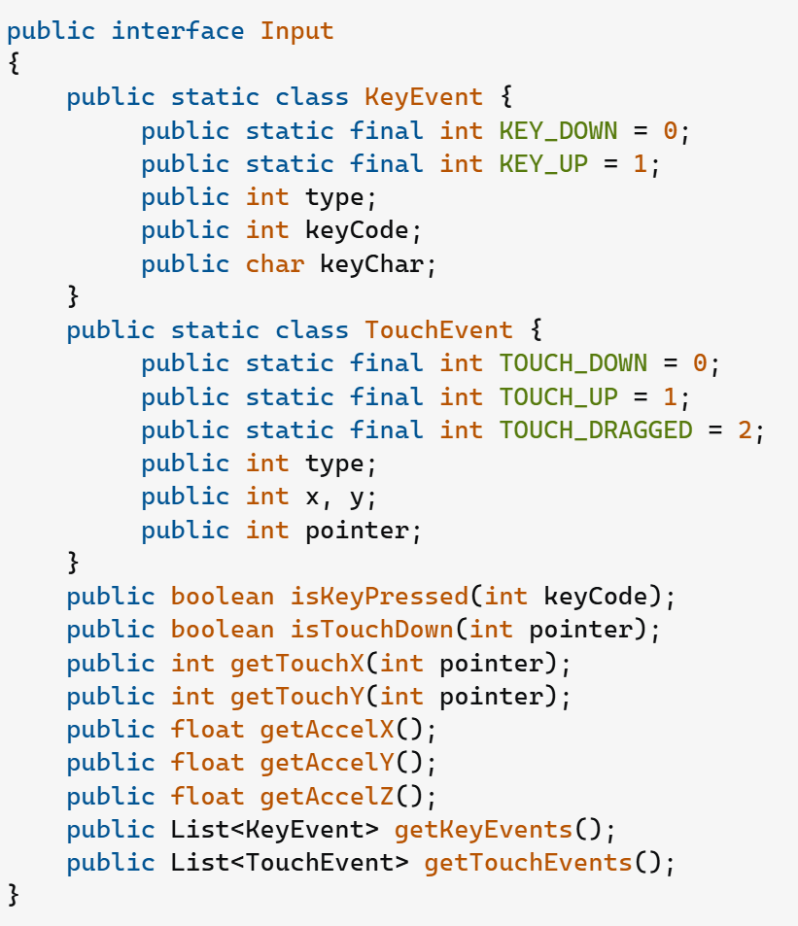
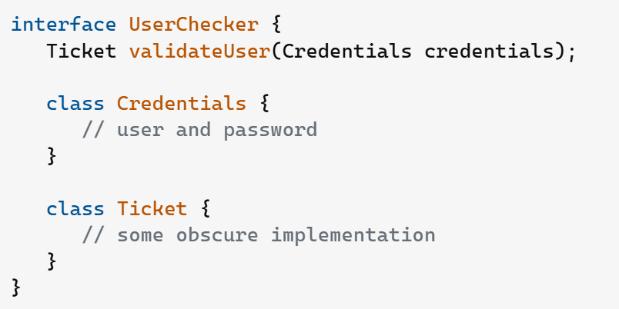

Slide 94
ENUM enum in Java

Slide 95
enum in Java
an enum (short for "enumeration") is a special data type that represents a fixed set of constants.
Each constant is a static final instance of the enum class, and enums are commonly used when you have a set of related constants that won’t change, like days of the week, directions, or statuses.
enums can be placed inside methods, this approach is rarely used, as enums are typically intended for global constants. Defining an enum inside a method is only useful when you want the enum scope to be extremely limited and temporary for a particular method.

Slide 96
public class Main {
public static void main(String[] args) {
Day today = Day.MONDAY;
// Output the current day
System.out.println("Today is: " + today);
// Switch statement with enums
switch (today) {
case MONDAY:
System.out.println("Start of the workweek!");
break;
case FRIDAY:
System.out.println("Almost the weekend!");
break;
case SATURDAY:
case SUNDAY:
System.out.println("It's the weekend!");
break;
default:
System.out.println("Just another weekday.");}}}
enum Day {
MONDAY, TUESDAY, WEDNESDAY, THURSDAY, FRIDAY, SATURDAY, SUNDAY
}

Slide 97
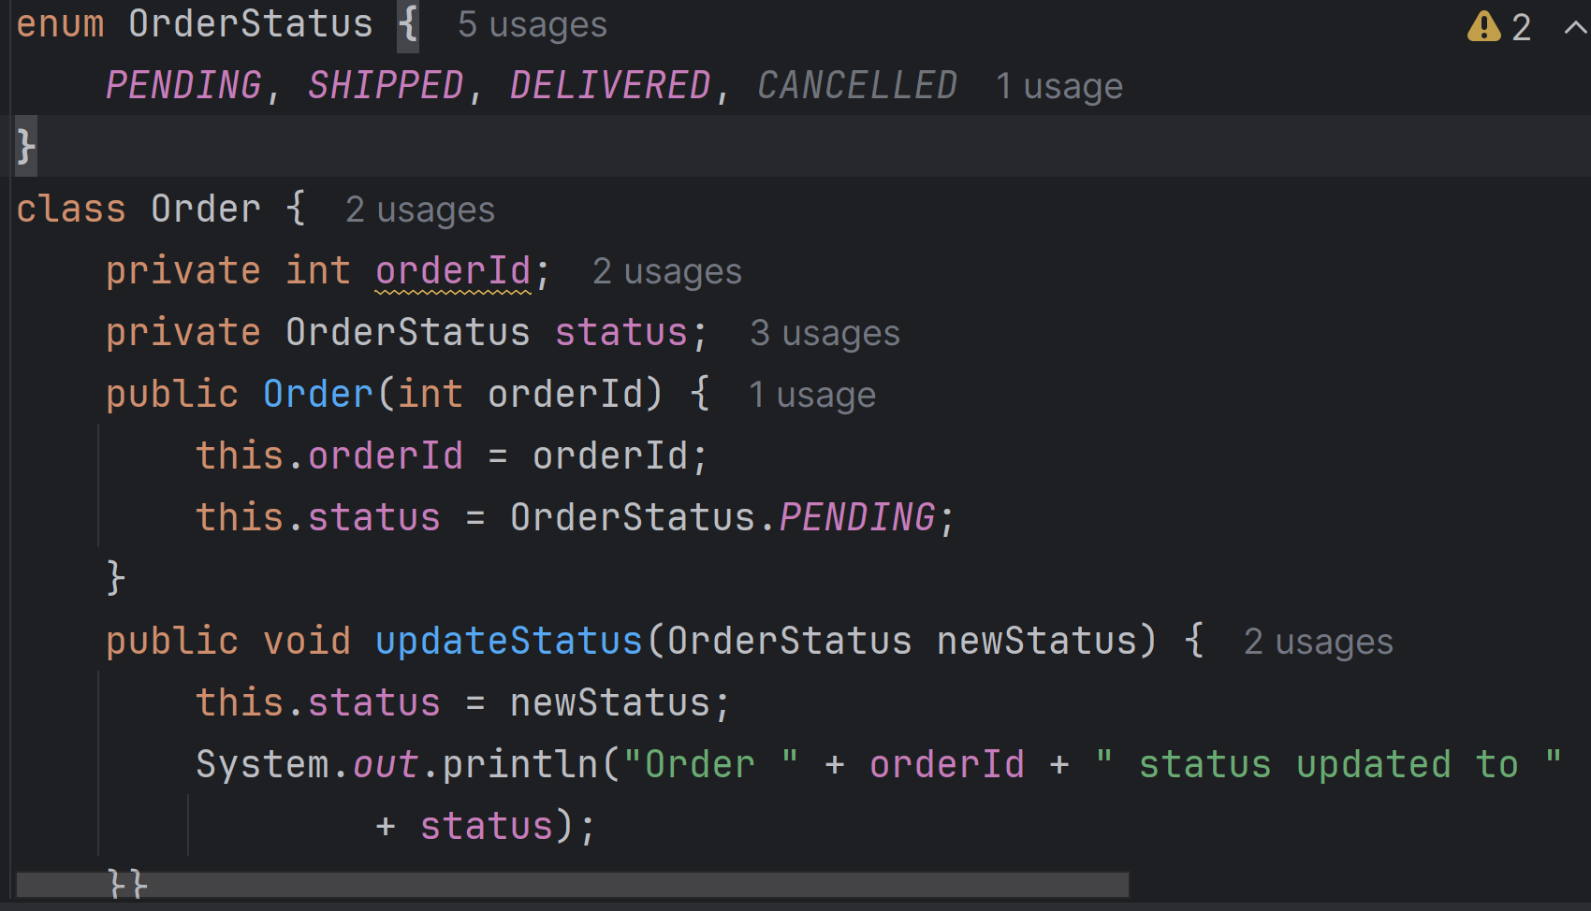

Slide 98
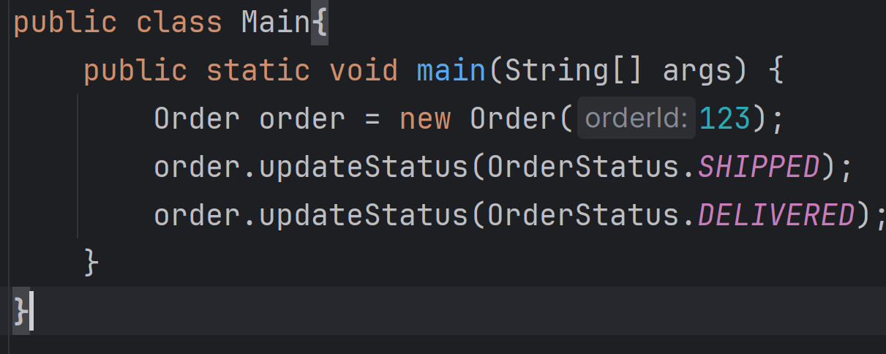

Slide 99
Benefits of Enums
Type-Safe Constants: Enums provide a type-safe way to define constants. You can only use predefined values of the enum type, reducing errors.
Readable Code: Enums improve code readability by clearly defining a set of valid values.
Enhanced Functionality: Enums can contain fields, methods, and constructors, making them more powerful than traditional constants.Enums are a structured, type-safe way to represent a fixed set of constants and provide a clean, efficient alternative to defining multiple static final variables.

Slide 100
Generics in Java

Slide 101
Generics in Java
Generics means parameterized types.
It is possible to create classes that work with different data types.
An entity such as class, interface, or method that operates on a parameterized type is a generic entity.

Slide 102
Types of Java Generics
Generic Method: Generic Java method takes a parameter and returns some value after performing a task. It is exactly like a normal function.
Generic Classes: A generic class is implemented exactly like a non-generic class. The only difference is that it contains a type parameter section. There can be more than one type of parameter, separated by a comma.

Slide 103
Generic Class
To create objects of a generic class, we use the following syntax.
public class BaseType<T> { // Class implementation }
BaseType <Type> obj = new BaseType <Type>()

Slide 104
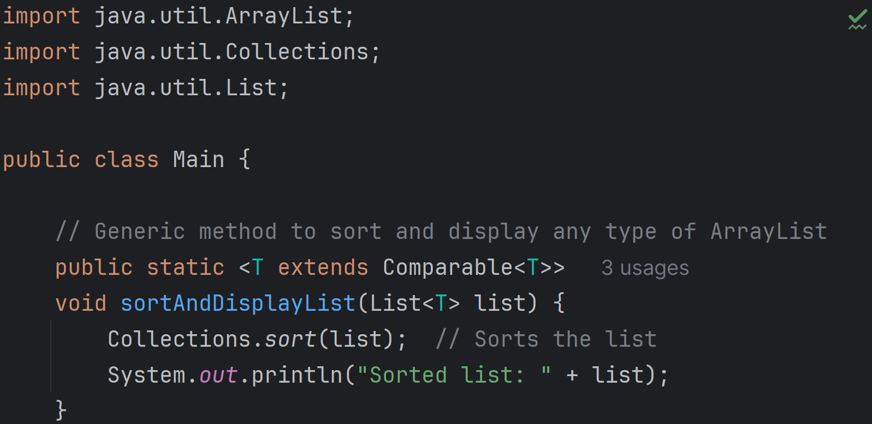

Slide 105
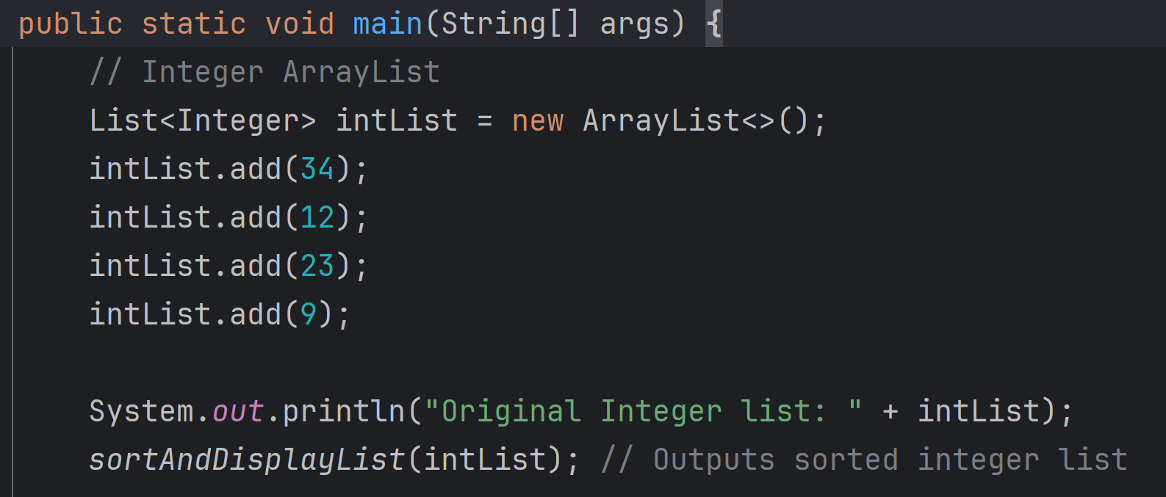

Slide 106
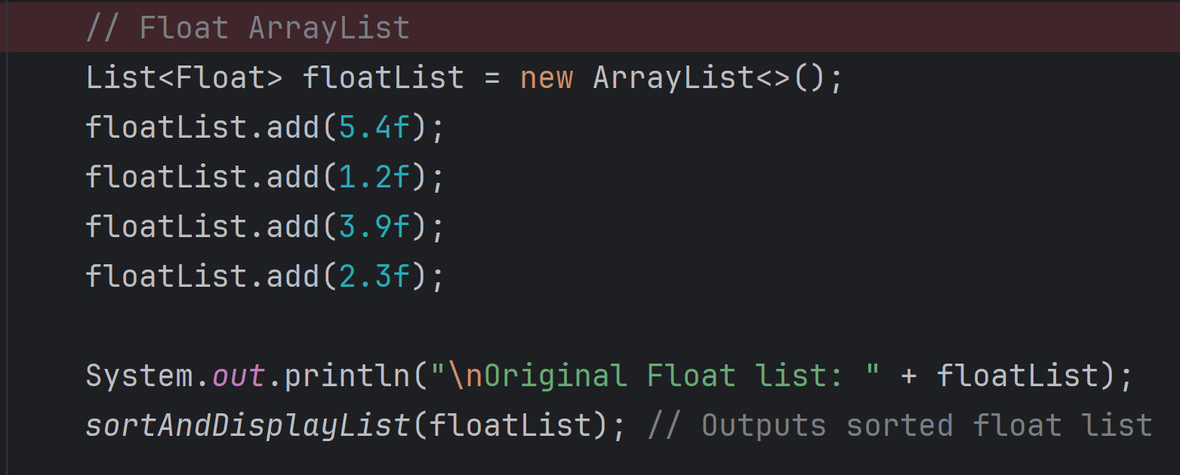

Slide 107
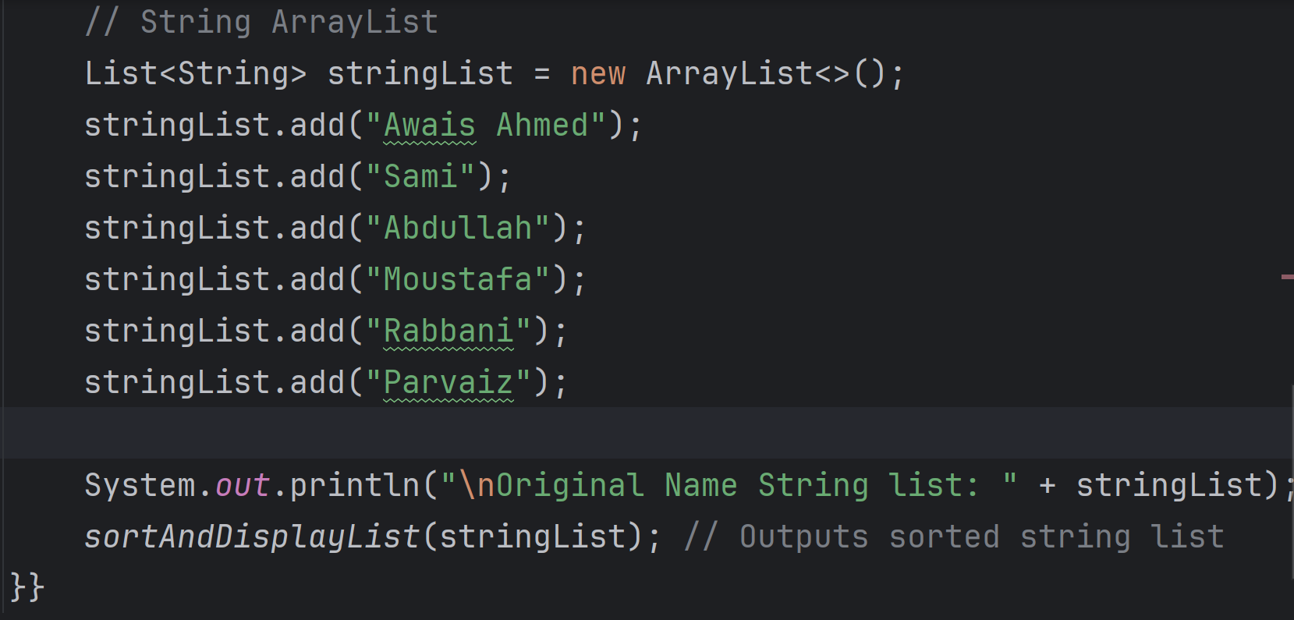

Slide 108
Example 1
class Test<T>
{
T obj;
Test(T obj) { this.obj = obj; } // constructor
public T getObject() { return this.obj; }
}

Slide 109
Example 1 (Continue..)
class Main {
public static void main(String[] args)
{
Test<Integer> iObj = new Test<Integer>(15);
System.out.println(iObj.getObject());
Test<String> sObj= new Test<String>(“Object Oriented Programming");
System.out.println(sObj.getObject());
}
}

Slide 110
Example 2
class Test<T, U>
{
T obj1; // An object of type T
U obj2; // An object of type U
Test(T obj1, U obj2)
{
this.obj1 = obj1;
this.obj2 = obj2;
}
public void print() { System.out.println(obj1); System.out.println(obj2); }}

Slide 111
Example 2 (Continue..)
class Main
{
public static void main (String[] args)
{
Test <String, Integer> obj = new Test<String, Integer>(“OOP", 1145);
obj.print();
}
}

Slide 112
Generic Functions
We can also write generic functions that can be called with different types of arguments based on the type of arguments passed to the generic method.

Slide 113
class Test {
static <T> void genericDisplay(T element) { System.out.println(element); }
}
Public main{
public static void main(String[] args)
{
genericDisplay(11);
genericDisplay(“OOP");
genericDisplay(1.0);
}
}

Slide 114
Write a JAVA program specifically generic method for sorting an array of int/float with one generic method.
static <T> void sortArray(T element)

Slide 115
Advantages of Generics
Code Reuse: We can write a method/class/interface once and use it for any type we want.
Type Safety: Generics make errors to appear compile time than at run time (It’s always better to know problems in your code at compile time rather than making your code fail at run time).

